Slide 1

Mastering Data Warehousing and Business Intelligence

Slide 2





What will you learn today?
What is Data Warehousing
What is Business Intelligence (BI)
Relation between Data Warehousing and BI
A look at Data Warehousing and BI tools
Hands-On

Slide 3
Data is everywhere
Data is everywhere yet …
I can’t find the data I need – data is scattered over many versions with subtle differences
I can’t understand the data I found – data is not well documented
I can’t use the data I found – data needs to be transformed from one form to other

Slide 4

Why care about data ?
Why care about data so much ?

Slide 5

Making Decisions with data
Data helps making decisions , a decision made without considering data is simply a guess

Slide 6
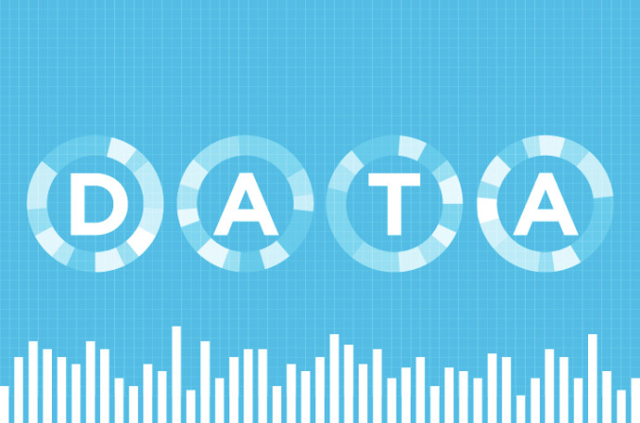
Insights from data
What went wrong ?
What can be done to improve the quality ?
What impact will new products have on revenue ?
Which product have been the biggest success ?

Slide 7
Where data resides ?
Data is mostly stored in Databases or Data Warehouses
What’s the difference?

Slide 8

Database Vs. Data Warehouse
 | Database | Data Warehouse
Purpose | Data retrieval, updating and management | Data analysis and decision making
Application | OLTP (Online Transaction Processing) | Reporting and OLAP (Online Analytical Processing)
Format | Normalized | Denormalized
Time Frame | Current/Real-Time | Historical
Note that you can use a database as a data warehouse. It depends on, for which purpose you have design the database

Slide 9
What is Data Warehousing ?
A process of transforming data into information and making it available in a timely manner to make a difference
Data
Process
Information

Slide 10
What a Data Warehouse is good at ?
Among others, a data warehouse is the foundation for a successful business intelligence program
The Data Warehouse Institute
www.tdwi.org

Slide 11
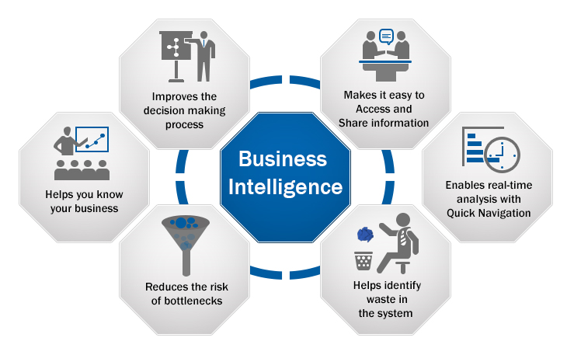
Business Intelligence (BI)
BI is a set of tools and techniques that enables analysis of information which improves business decisions

Slide 12
Applications of BI
Applications of business intelligence includes the following
Budgeting
Resource Allocation
Financial Modeling
Competitive Intelligence
… and many more

Slide 13
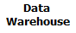
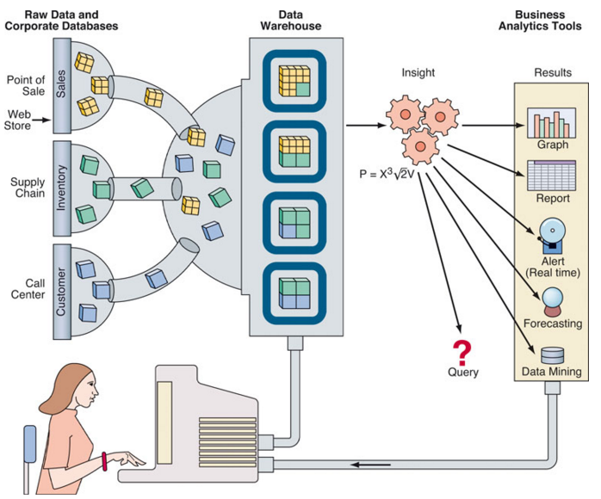





Data Warehousing and BI
Data Warehousing and BI go hand in hand

Slide 14
A look at Data Warehouse and BI Tools

Slide 15
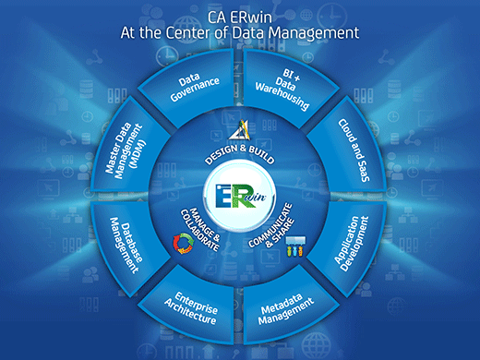
CA ERwin
CA ERwin provides a collaborative data modeling environment to manage enterprise data through an intuitive, graphical interface
CA ERwin combines both BI and Data Warehousing tool

Slide 16
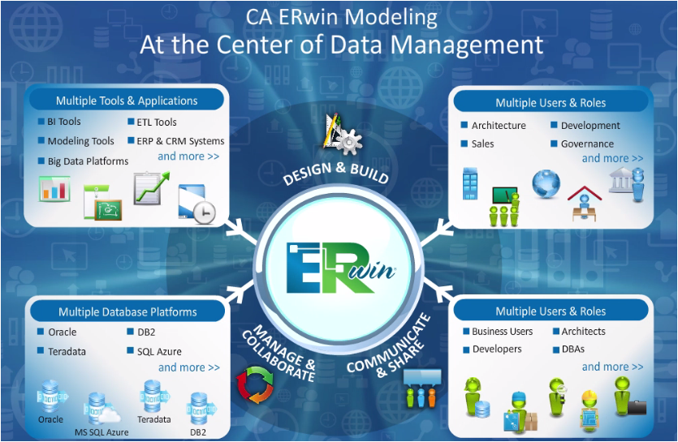
Features of CA ERwin

Slide 17
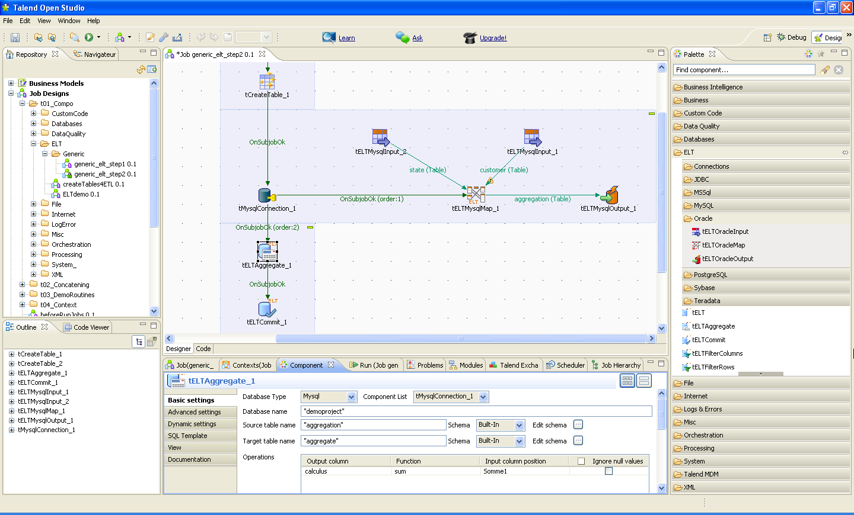
Talend Open Studio (TOS)
Talend Open Studio (TOS) is open source and free to use version of Talend for Data Integration
TOS is well suited for ETL (extract, transform, load) tasks

Slide 18
Hands-On

Slide 19

Survey
Your feedback is vital for us, be it a compliment, a suggestion or a complaint. It helps us to make your experience better! Please spare few minutes to take the survey after the webinar.

Slide 20
Thank You …
Questions/Queries/Feedback
Recording and presentation will be made available to you within 24 hours

